Slide 1
V3D Hackathon
Jon Luisi

Slide 2
Open Source
Cross Platform Compatibility
Ease of Installation
Compiler Support
Version Compatibility

Slide 3
Proposal of Farsight Plugins
Trace Editor
Large Scale Group Editing
Feature Analysis
Nucleus Editor
Segmentation
Classification
Preprocessing Tools
Tracing Algorithems

Slide 4
FTK Project File
Read and Montage Images and Tracing
XML File that records
File Name
File Type
Image
Soma
Tracing
Translation Coordinates

Slide 5
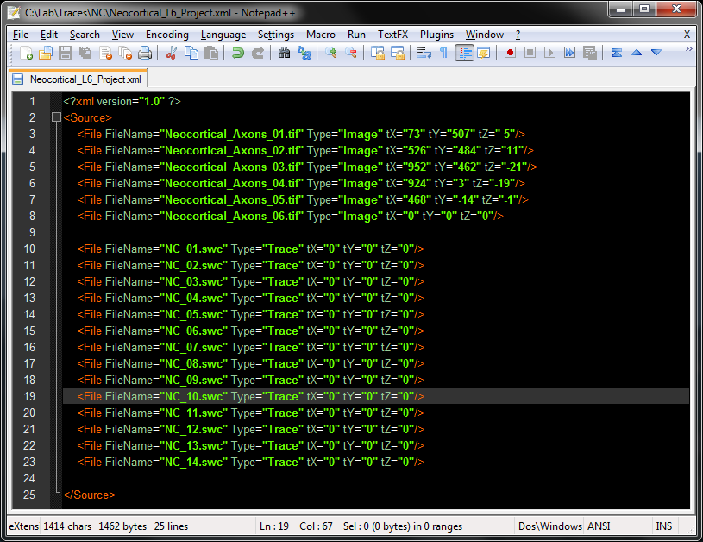
Sample Project File

Slide 6
Project Montage In FTK Trace Editor

